Slide 1




Video Game Sales analysis
By:
Lohith Reddy Poreddy - 16337814
Sai Venkat - 16336228
Sai Meghana - 16322813

Slide 2

Abstract:
The aim of this project is to explore a video game sales dataset and gain insights into the trends and patterns in the industry. The dataset contains information on video games released between 1980 and 2016, including their release year, platform, genre, publisher, and sales data in different regions. We performed data analysis to gain insights into the dataset, including the distribution of sales across platforms, genres, and regions, and the trends in sales over time. Our analysis showed that the most popular platforms and genres have changed over time, with a shift towards mobile and online gaming in recent years. Our analysis provide information to the investors and publishers about what genre of games would be more successful in different regions and on the type of games to invest.

Slide 3

Data:
The dataset contains 16 different columns and 16446rows. The data is all about various games from 1980 to 2016 and their sales globally and regionally.
The columns are Name, Platform, Year of release, Genre, Publisher, NA Sales, EU Sales, JP Sales, Other sales, Global sales, Critic Score, Critic count, User Score, User count, Developer and rating.
From the dataset around 40-50% of values were missing or Nan values in the factors ,Critic Score, Critic count, User Score, User count, Developer and rating.

Slide 4

Data cleaning:
In the dataset as 40 to 50% of the values were missing in some factor’s they have been dropped in the process of data cleaning.
Then a total of 10 factors were left and from the remaining data 34 values were missing. As the publisher data is missing the missing value rows have been dropped.
After cleaning the data, size of the dataset is 16412 rows and 10 factors.

Slide 5
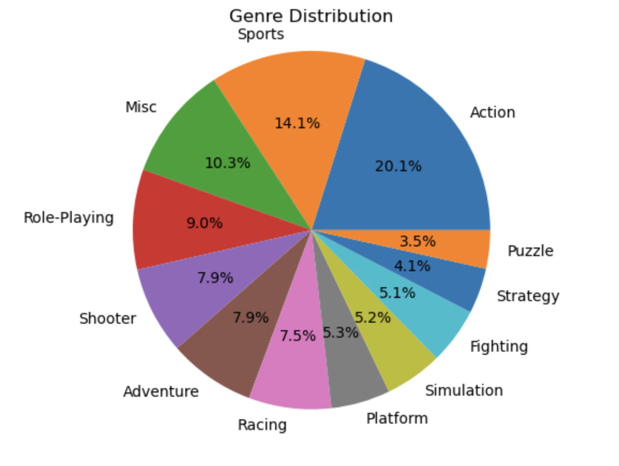
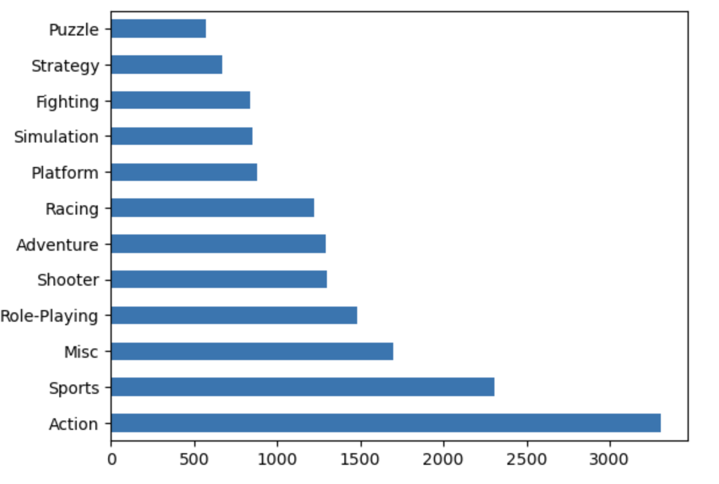
genre:
Total games released in each genre
Genre
Count

Slide 6
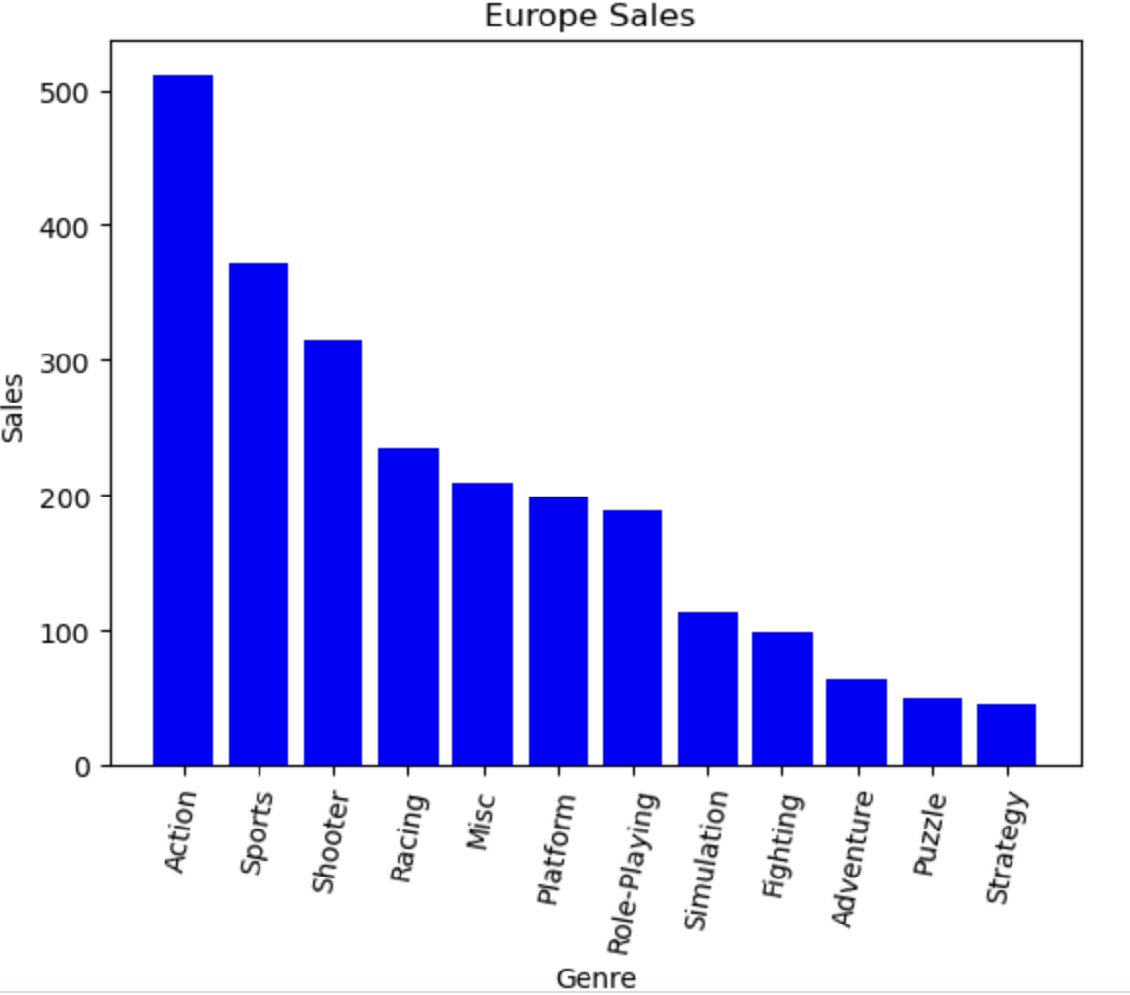
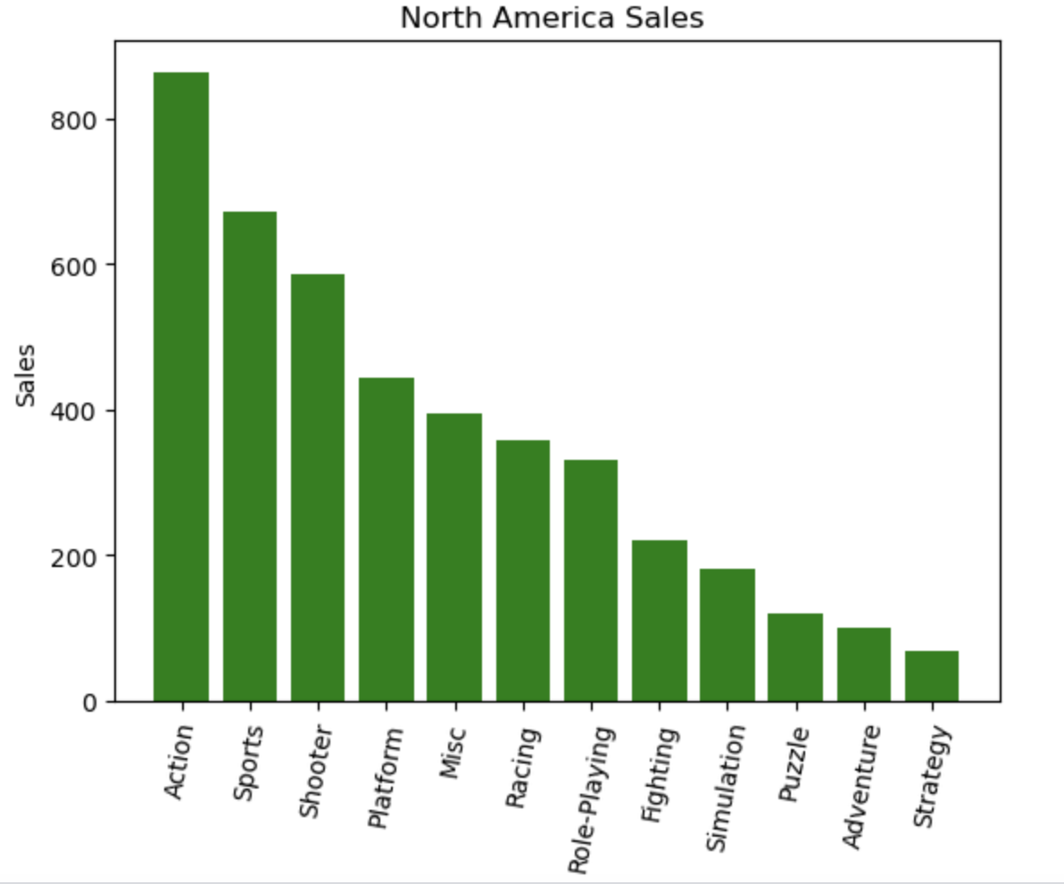
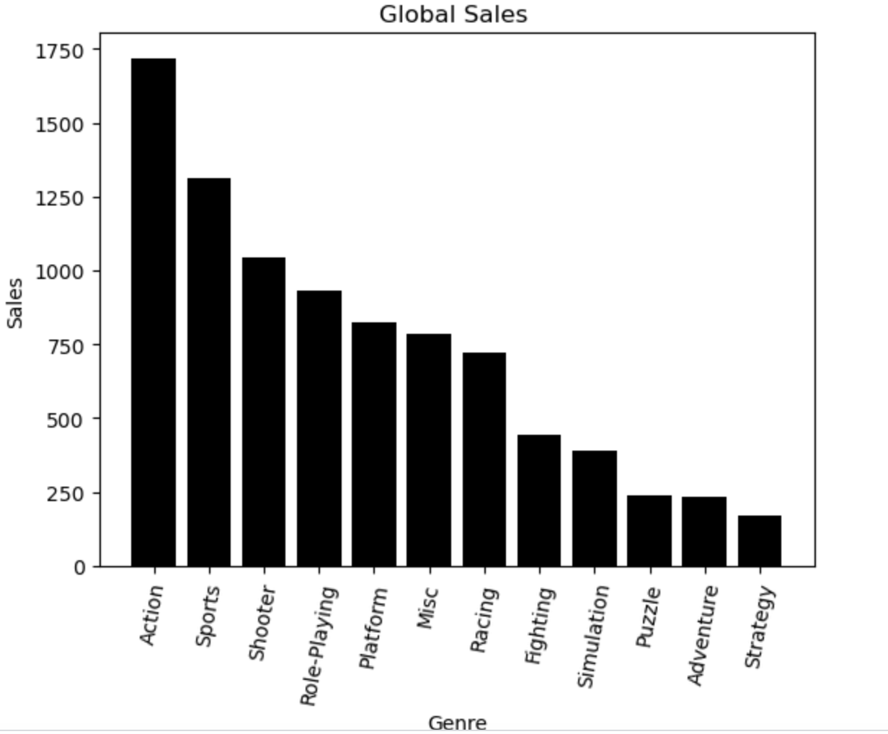
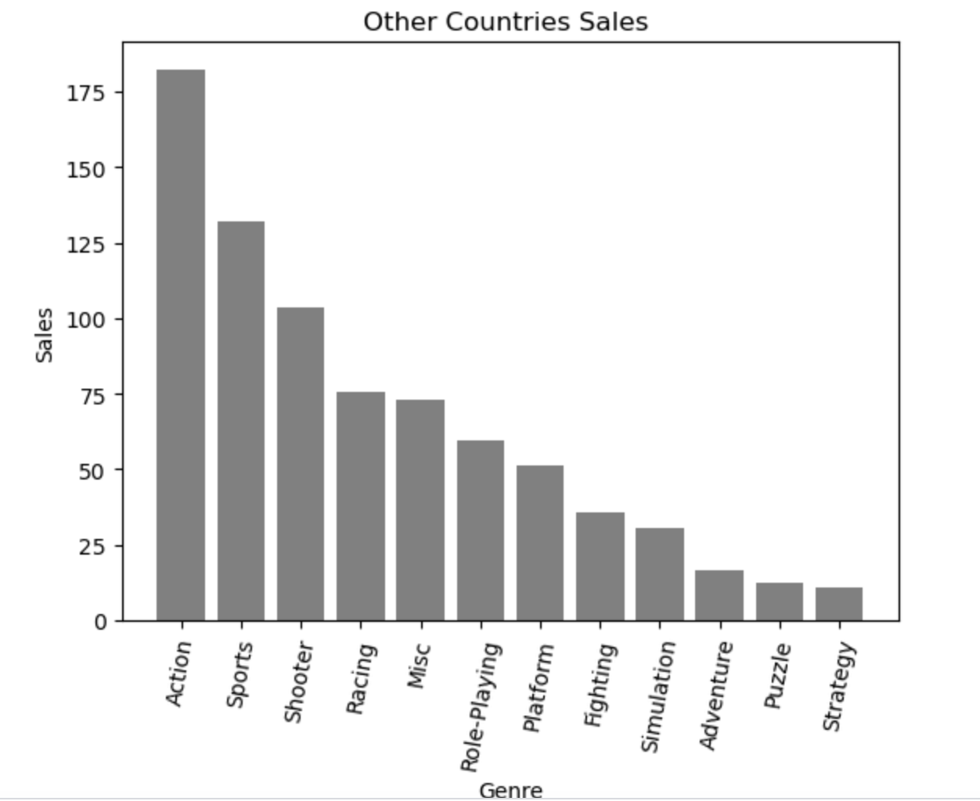
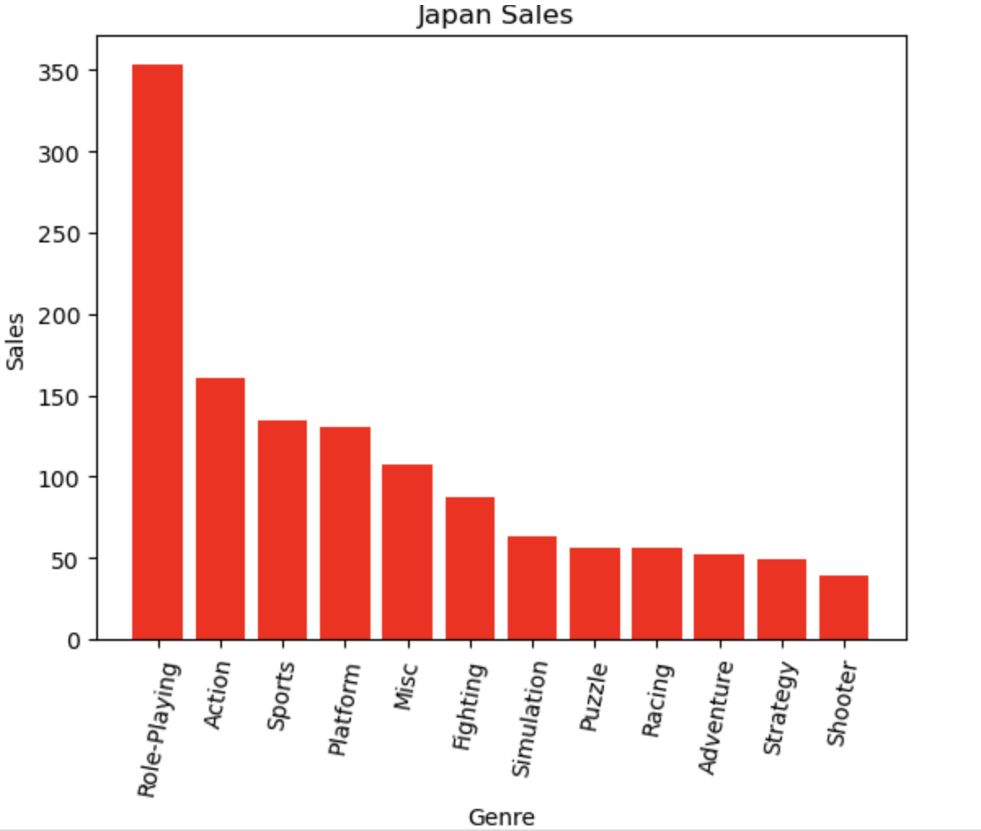

Slide 7
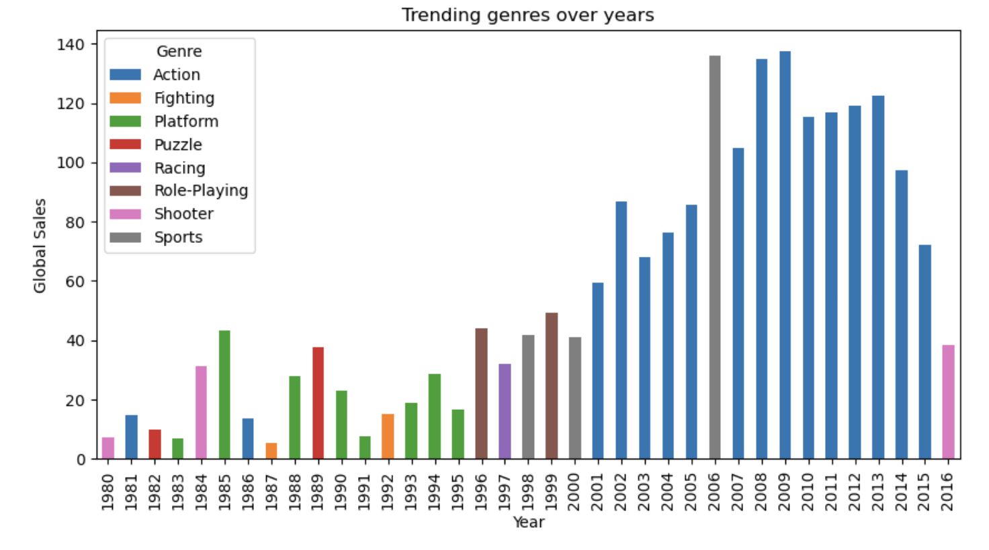

Slide 8
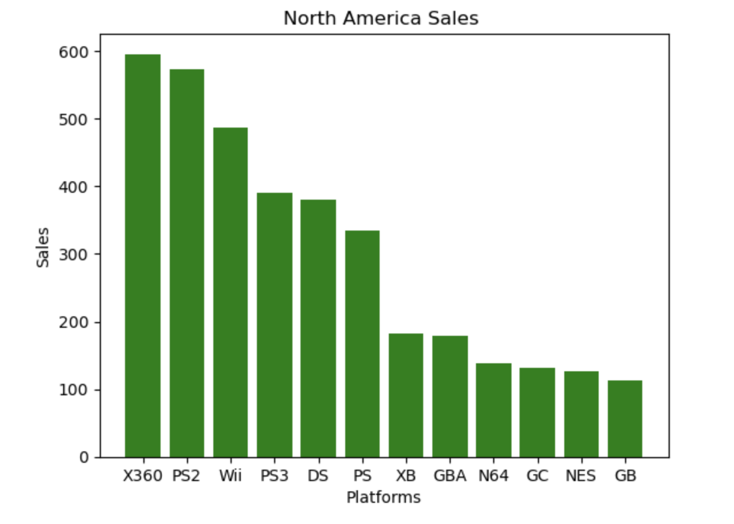
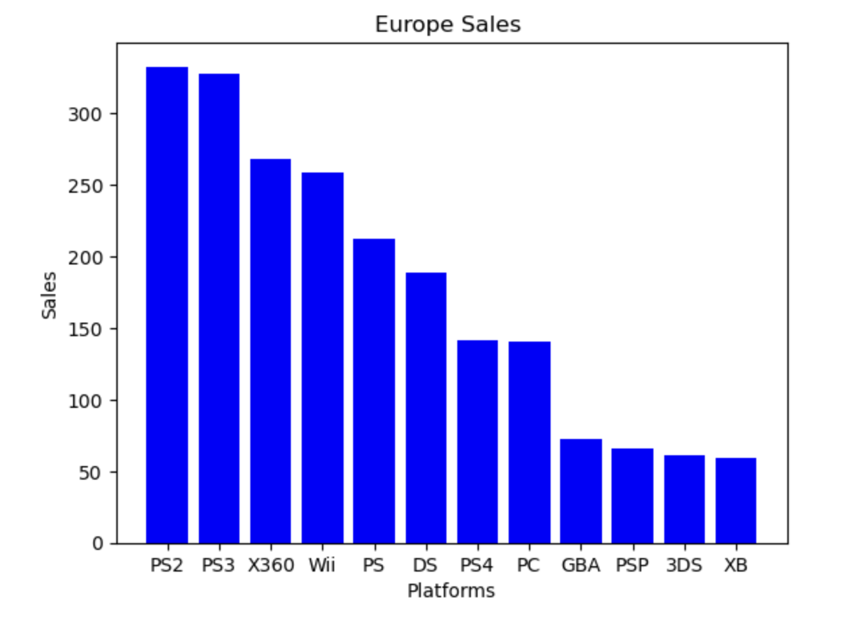
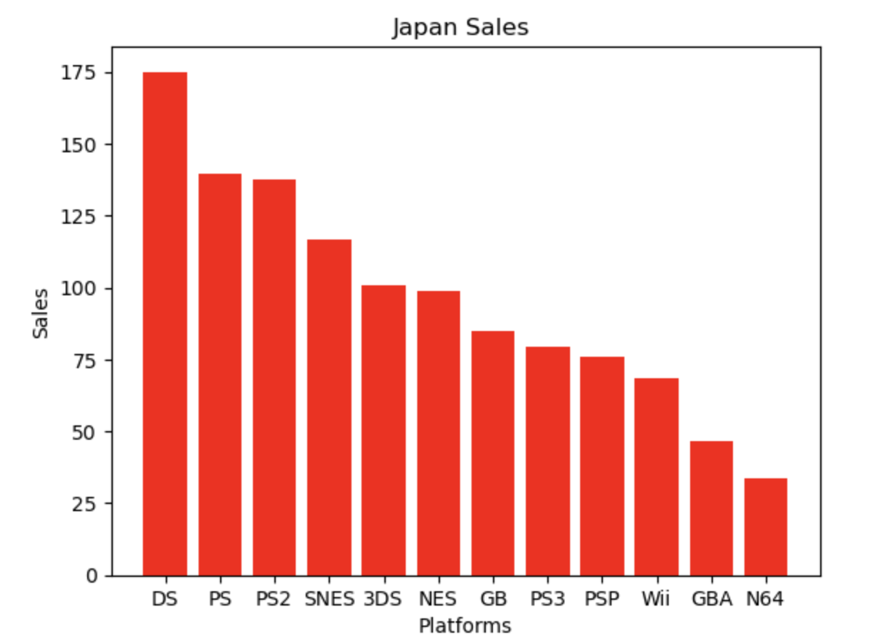
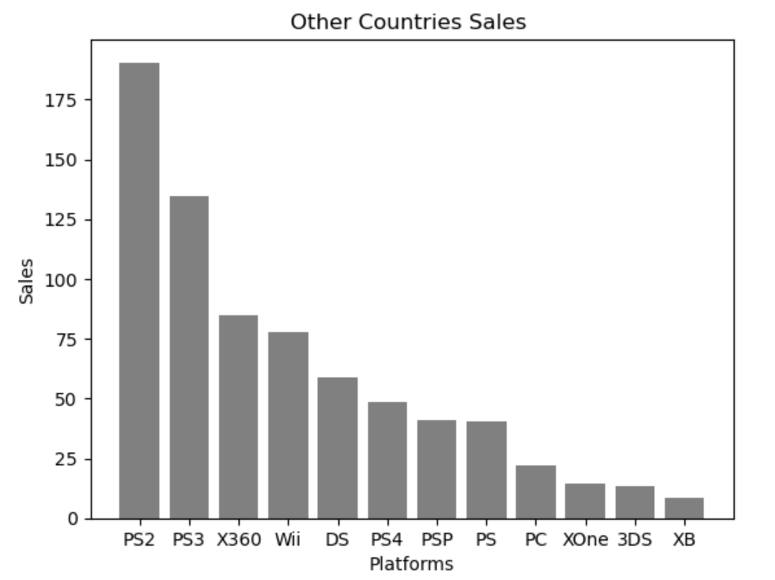
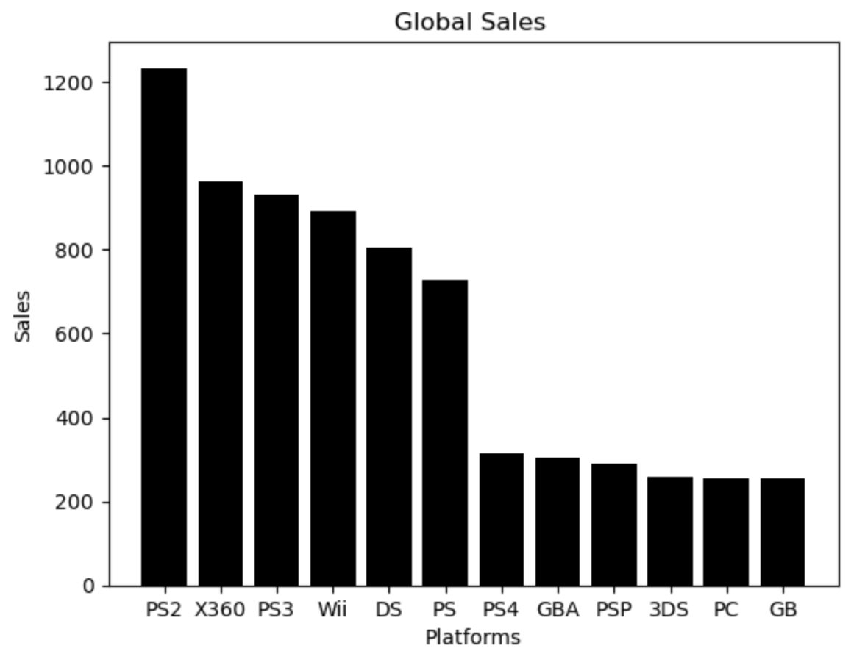
Platform:

Slide 9
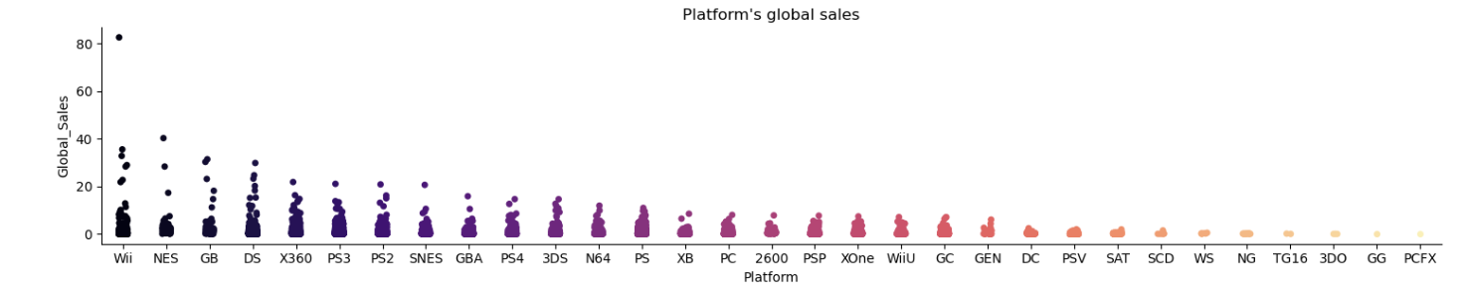
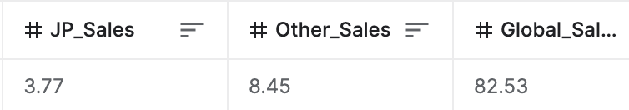
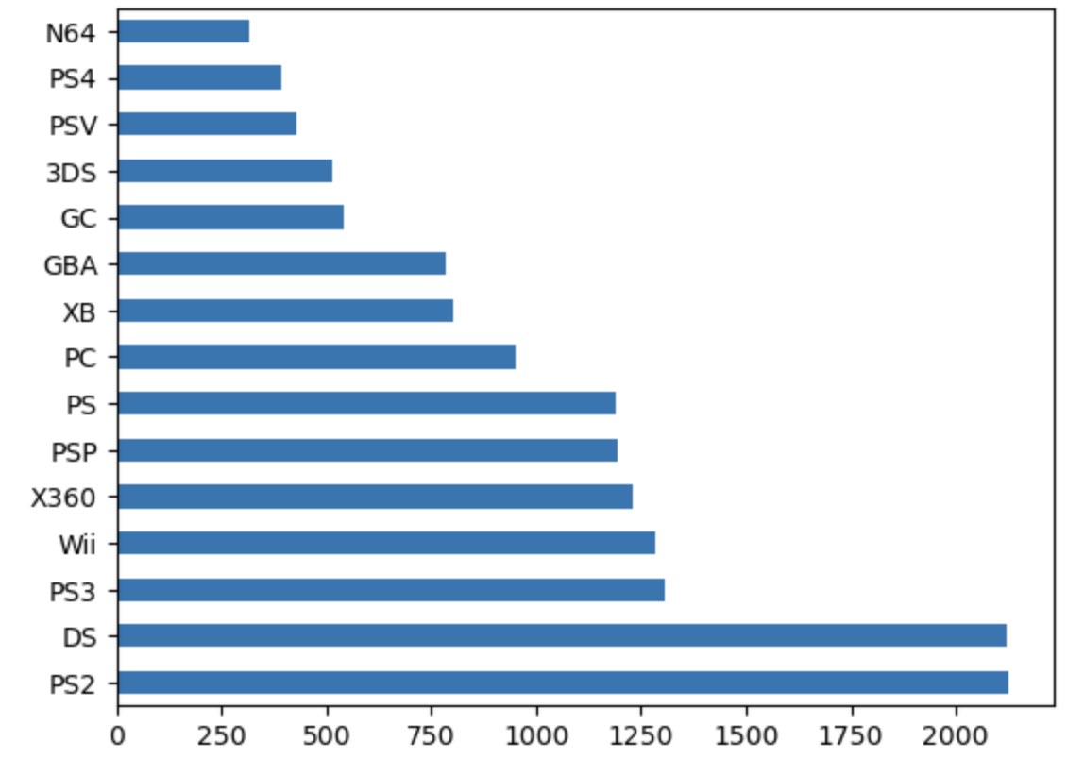
From the above plot we can see that there is one game which has Wii as platform and sales above 80 million. The game that has the highest sales is Wii Sports.
Total games released by each platform
This plot provides details about the number of games released by top 15 platforms
Platform
Count

Slide 10
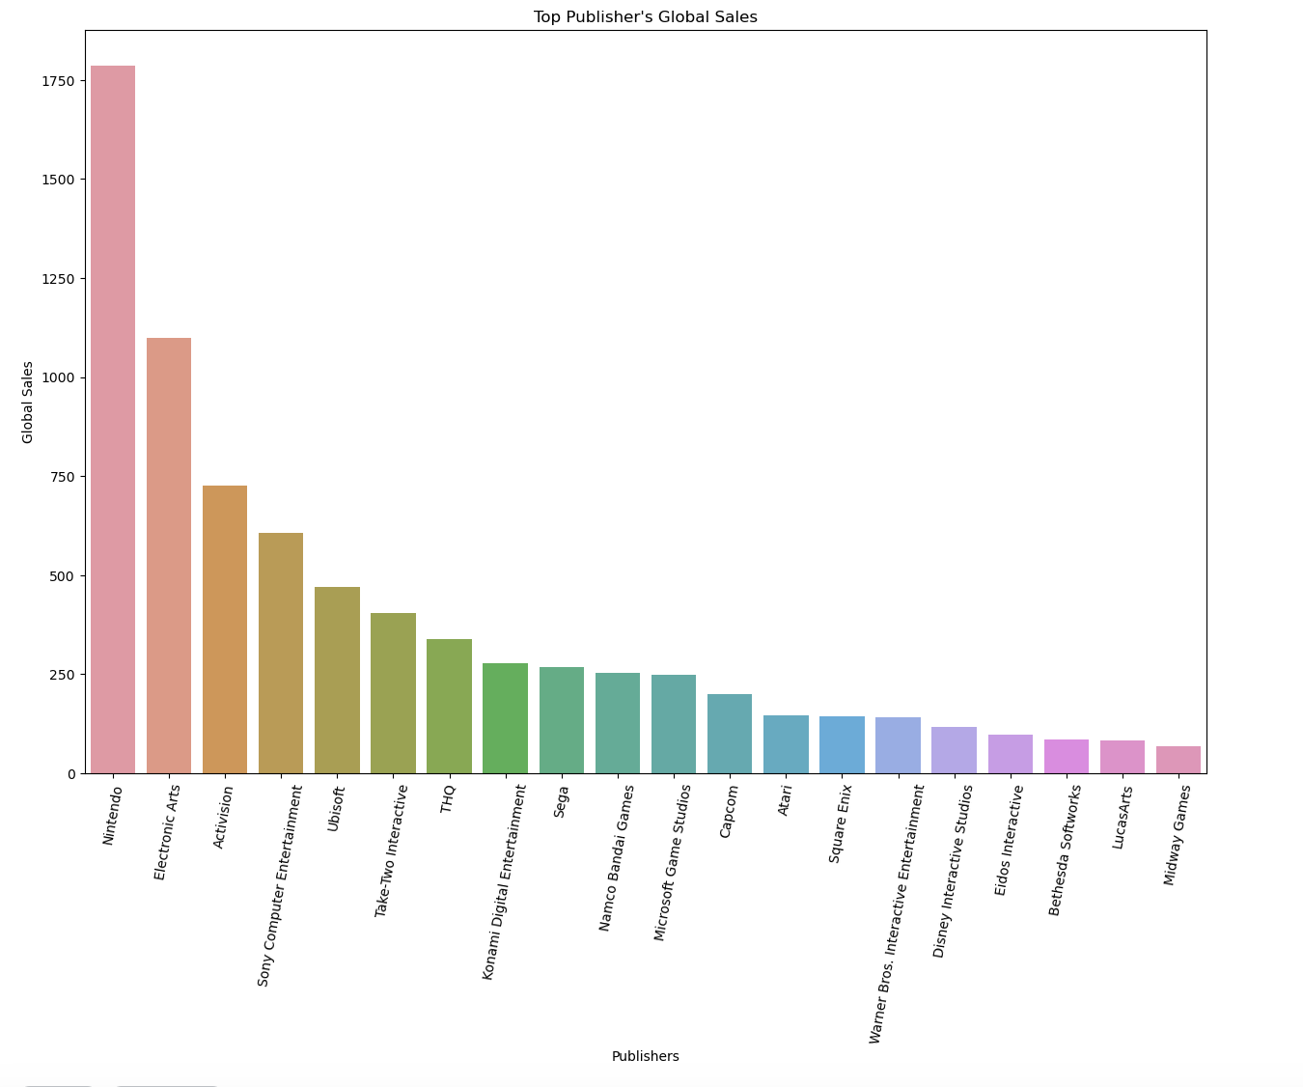
Publisher:

Slide 11
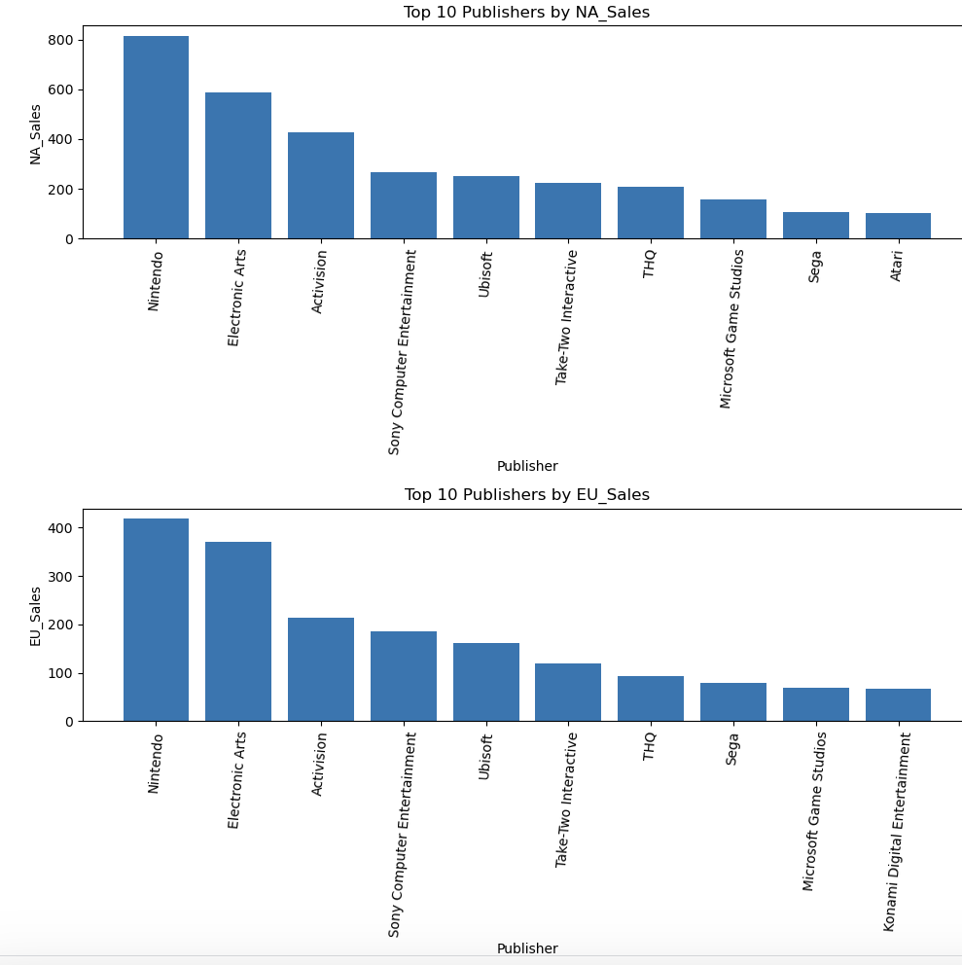
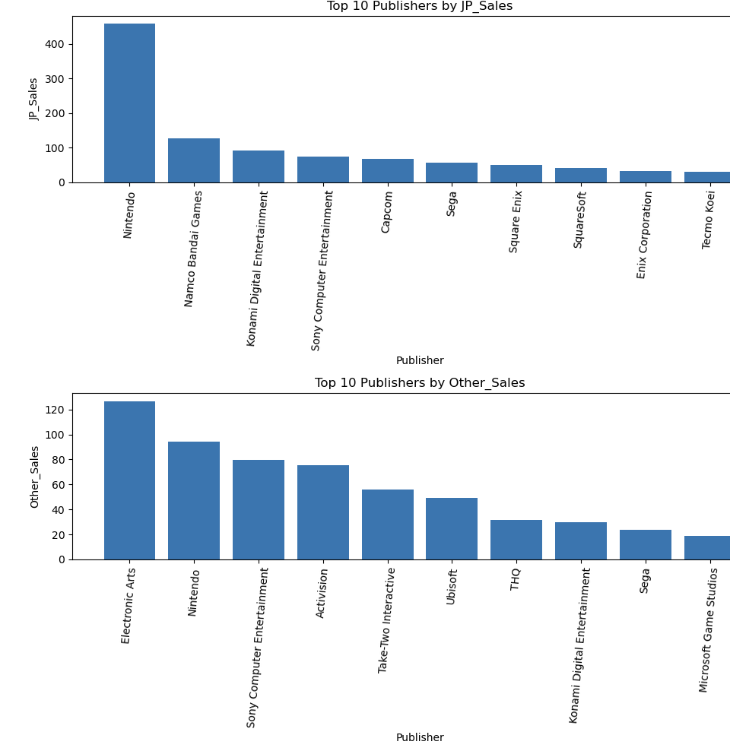

Slide 12
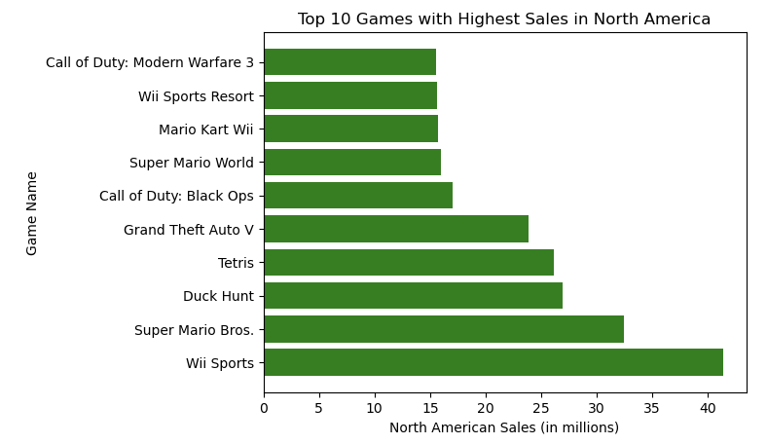
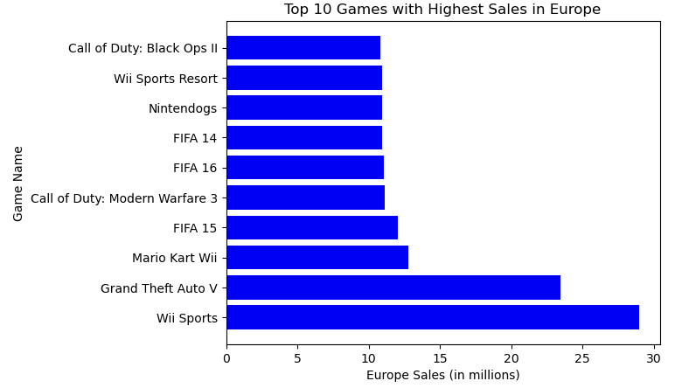
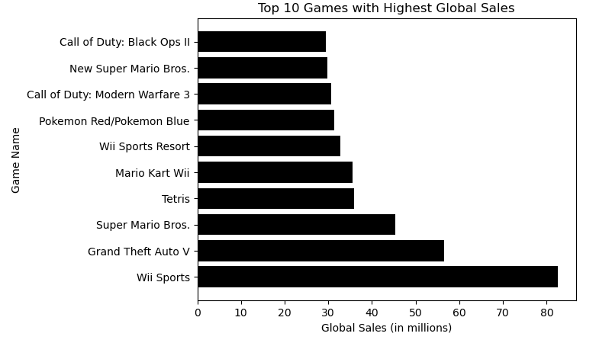
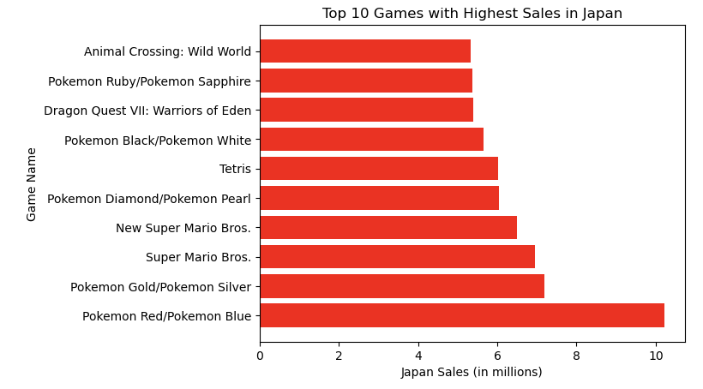
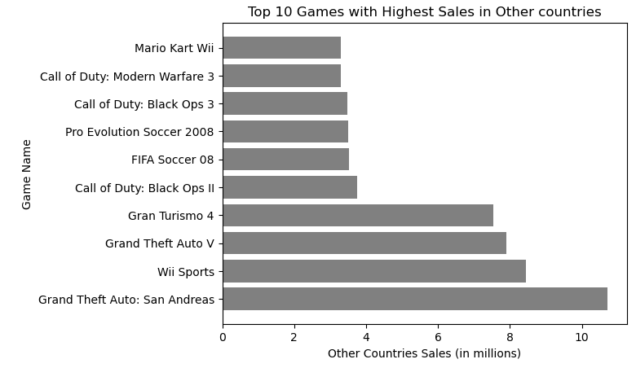
Games:

Slide 13
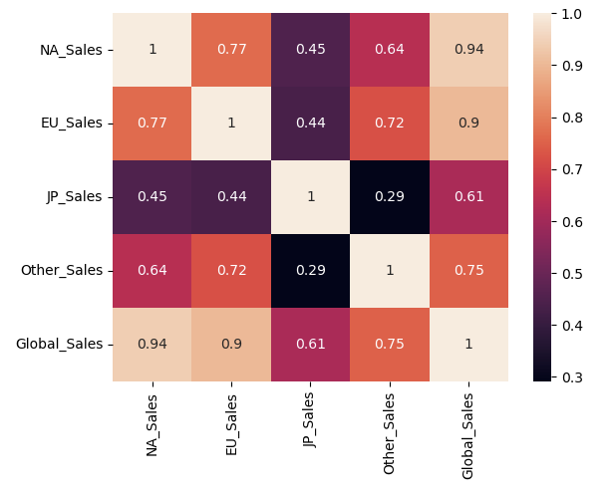
Correlation matrix:
Global Sales and North America Sales have a correlation coefficient of 0.94, indicating a strong positive correlation.
Japan Sales and Other Sales have a correlation coefficient of 0.29, indicating a weak positive correlation.
There is a moderate positive correlation between global sales and features such as North America, Europe, and Japan sales, indicating that global sales are a good indicator of overall success.

Slide 14
conclusion
The most popular video game genres are action, sports, and shooter, while the least popular are strategy, puzzle, and adventure.
The most successful video game platforms in terms of sales are the PlayStation 2, Xbox 360, and PlayStation 3.
There is a strong positive correlation between the sales of different regions, indicating that video game sales tend to be similar across different regions.
Electronic Arts, Activision, and Ubisoft are the top publishers in terms of sales, and they tend to release games on multiple platforms.
Nintendo is a notable publisher that focuses on its own platforms such as the Wii and the Nintendo DS and has been successful in doing so.
The top-selling video game of all time is Wii Sports, which was developed and published by Nintendo.
Compared to other regions the Japanese gaming industry is different.

